Slide 1
Part 0
From the reading:
Many of the interviewed famous programmers mentioned that good code has minimal “dependencies”.
In this context, what is a dependency?

Slide 2
Part 1 Working From a Design
IN710 Object Oriented System Development
Semester 1, 2017
Session 1.2
Notes:
Implement your bridge dealer.
You have 45 minutes.
If you have planned completely this should be plenty of time.

Slide 3
Part 2 Dealing with Change
Dealing with Change

Slide 4
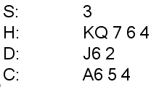
Display Format
Real bridge hands are displayed in this format:
Now we will modify someone else’s Bridge Dealer application to display hands correctly.

Slide 5
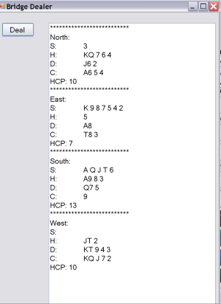
Modifying Bridge Dealer
Take the new Bridge Dealer application as advised, and modify it to produce the new display format. (Please note that Aces are the highest ranking card in the suit.)
Notes:
On the I drive you will find four bridge dealers written by students in 2010’s class.
Copy the one corresponding to your number, and modify it to display the new format.
You have 45 minutes
Think carefully about how difficult or easy this modification is:
What changes do you have to make?
What aspects of the design make those changes necessary?
Could the design have been different to reduce the amount of work required for the modification?
We will discuss

